Slide 1
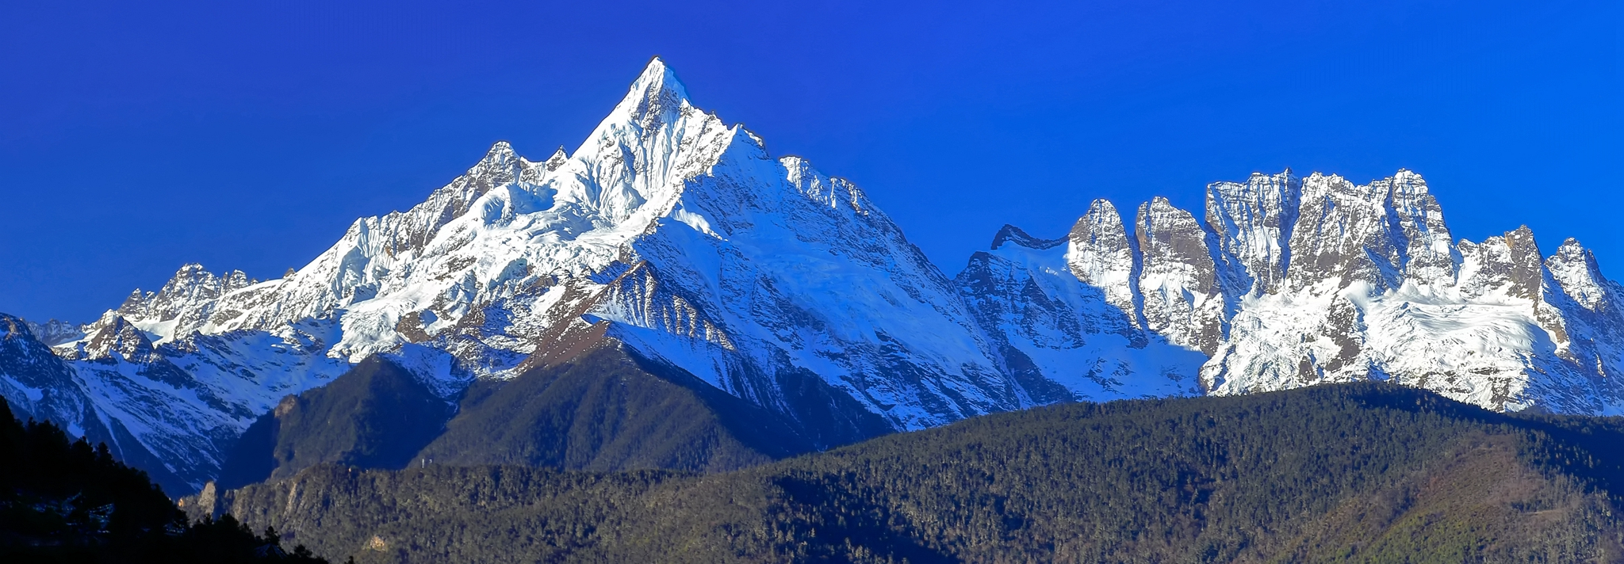
Accurate Estimation of Snow Water Equivalent (SWE) using Long short-term memory (LSTM)
Independent Research Project
Yulin Zhuo
Superviosrs: Niamh French, Philippa Mason, Corinna Frank

Slide 2

Background Introduction
Proposed Solution
Results

Slide 3

Background introduction
The Importance of SWE
Traditional Estimation Methods
Deep Learning in SWE estimation

Slide 4

Background introduction the importance of SWE
Climate Change Impact:
Consistent forecasts of near-surface warming due to greenhouse gases (Barnett et al., 2005).
Effects: Decreased winter snowfall, faster spring snow melt, shifted peak river runoff timing.
Significance of SWE:
Defines the total water content in snowpack.
Essential for areas like California with major water storage in snowpack (Siirila-Woodburn et al., 2021).
Implications for agriculture, flood prevention, and daily water consumption for 1.2 billion people globally.
Notes:
There are evidence showing that, our hydrological systems are undergoing dramatic shifts due to the rise in greenhouse gases.
A warmer climate leads to decreased snowfall and quicker snow melting in spring. One of the example results is Western U.S., for instance, is seeing less mountain snowpack, and soon, spring stream flows will occur a month earlier than usual.
SWE is a metric measuring the total water in snowpacks.
The accurate measurement of SWE is important especially for the area like California, where the majority of water storage is from snowpacks.
There are 1.2 billion people in the world depending on snowmelt water for daily consumption. The accurate measurement of SWE is important for not only water management but also agriculture, and flood prevention. The proper SWE estimation can help to do early-warning against floods.

Slide 5
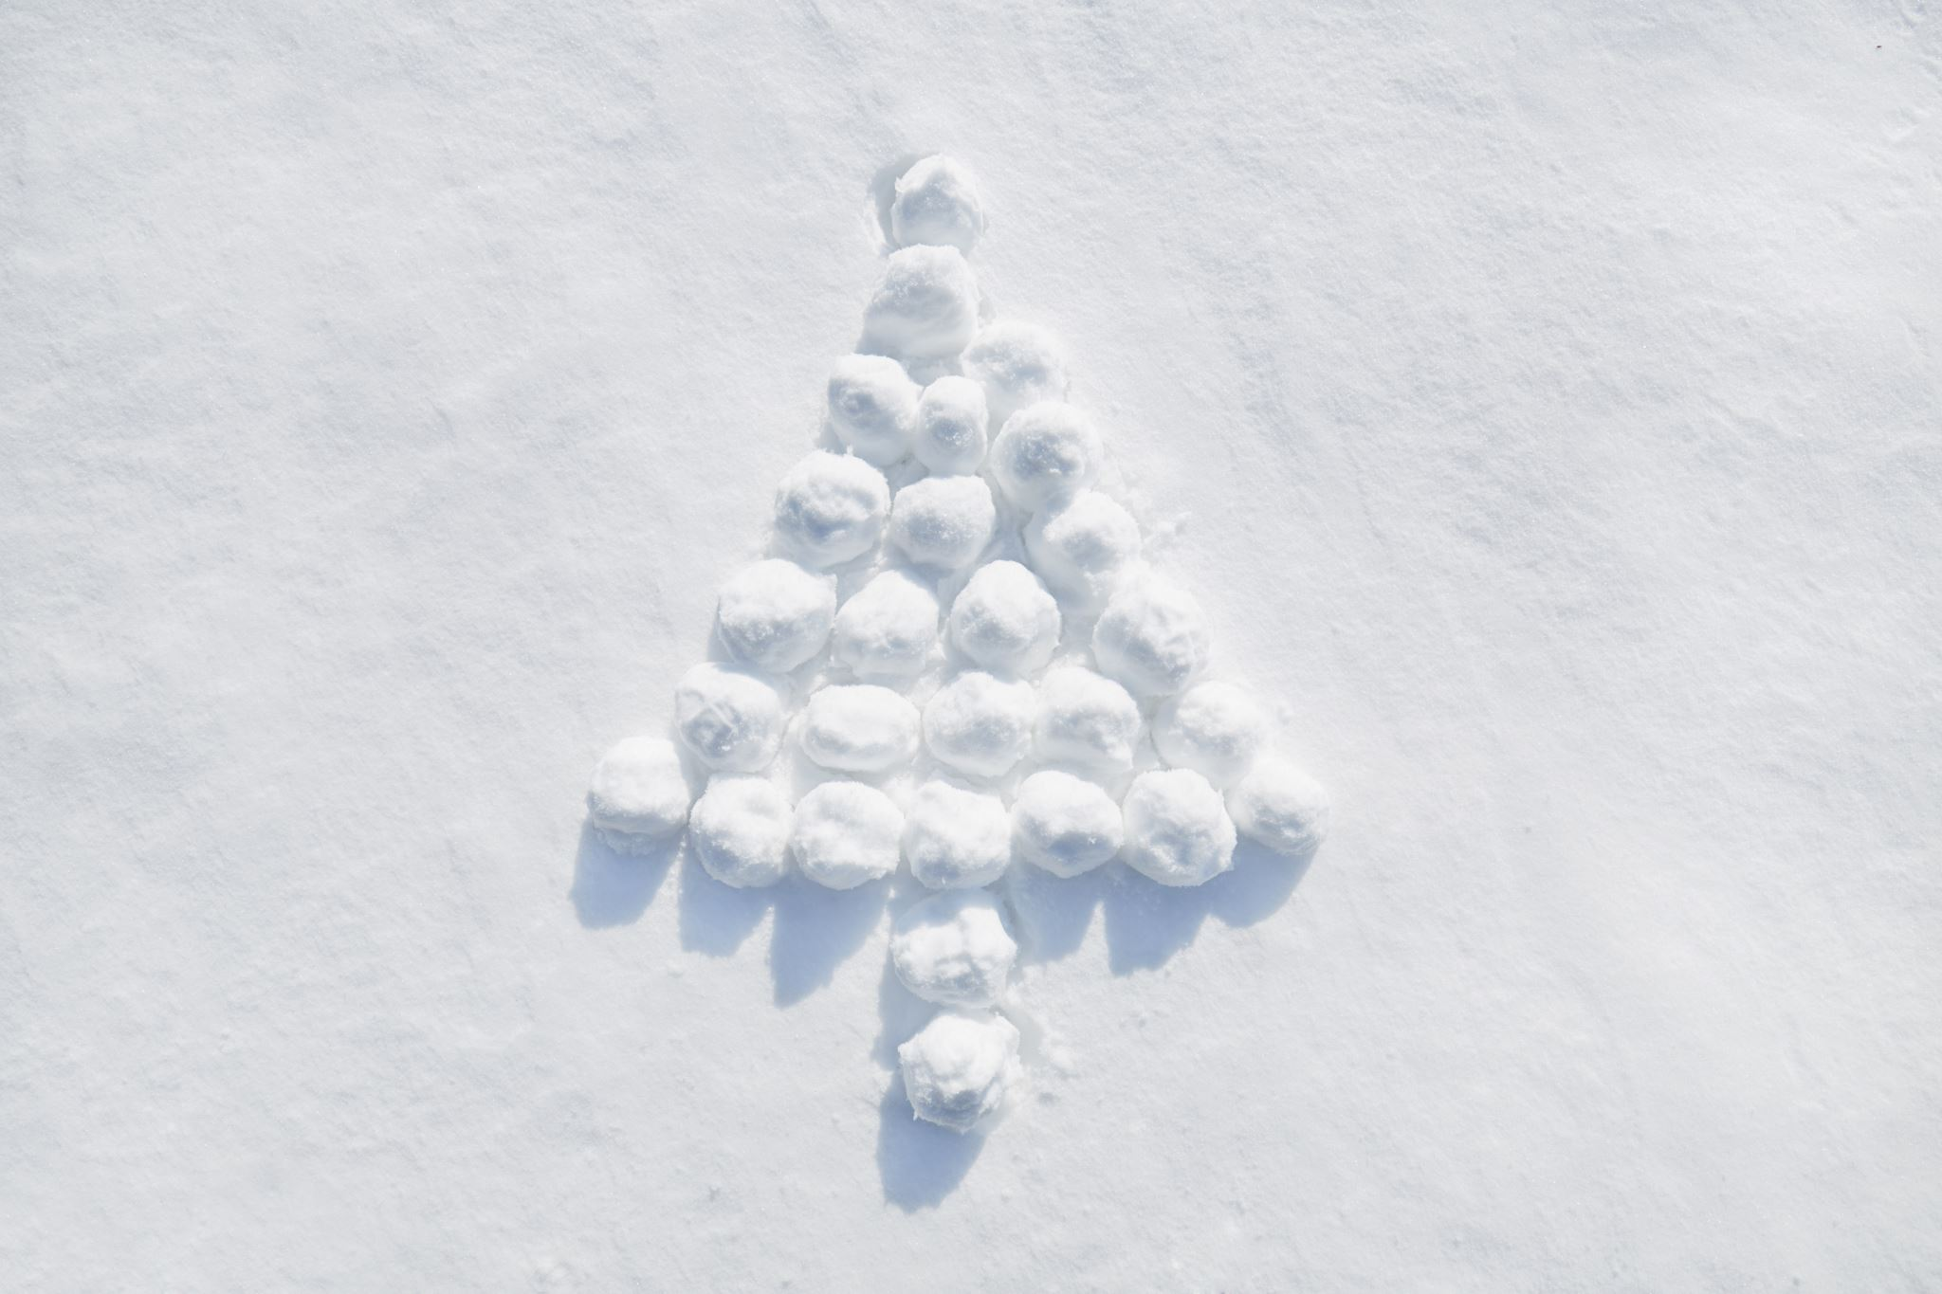
Background introduction Traditional Estimation Methods
Thermodynamic Snow Models:
Focus on mass and energy balances.
High data requirements, especially atmospheric variables (Winkler et al., 2021).
Empirical Regression Models (ERMs):
Linear relationship between snow depth and SWE.
Some of them are limited in daily resolution capacity (Jonas et al., 2009).
Semi-empirical Models:
Combination of theory and empirical data.
Dependence on initial conditions like density.
Notes:
Traditionally, snow water equivalent is estimated by converting snow depth measurements to SWE using estimates of snow density. Traditional methods such as thermodynamic Snow Models, empirical regression models and Semi-empirical Models have their own strengths and limitations.
Thermodynamic Snow Models:
Thermodynamic Snow Models are focusing on the mass and energy balances. One challenge of these models is they have a high data requirement, particularly related to atmospheric variables.
Empirical Regression Models (ERMs):
And the Empirical Regression Models or lets say ERMs rely on a linear relationship between snow depth and SWE. They also have limitations. For instance, they cannot handle the predictions with daily resolution or higher, one example is the model by Jonas in 2009.
Semi-empirical Models:
Lastly, the Semi-empirical Models strike a balance. They're a blend of theory and empirical data. But they are highly rely on initial conditions, such as density.

Slide 6

Background introduction Deep Learning in swe estimation
Artificial Neural Networks (ANNs):
Recent advancements in SWE estimation (Ntokas et al., 2021).
Challenges:
Specific high data requirements, such as ‘days without snow since the beginning of winter’, and ‘total solid precipitation in the last 10 days’.
Only focus on a specific region
Notes:
There have been promising developments in using Artificial Neural Networks for modeling SWE. These models have shown some success, However, the model still has relatively high data requirements, including ‘days without snow since the beginning of winter’, ‘total solid precipitation in the last 10 days’, and more. Even though there are open-source websites that provide meteorological data, many of them do not provide these specific measurements.
The lack of transferability is another problem. The models were usually trained on a specific region, such as ANN by Ntokas in 2021 are using the data from Canada only.

Slide 7

Proposed Solution
Data Overview
Methods Overview
1. Data Pre-processing
2. LSTM Model Construction

Slide 8
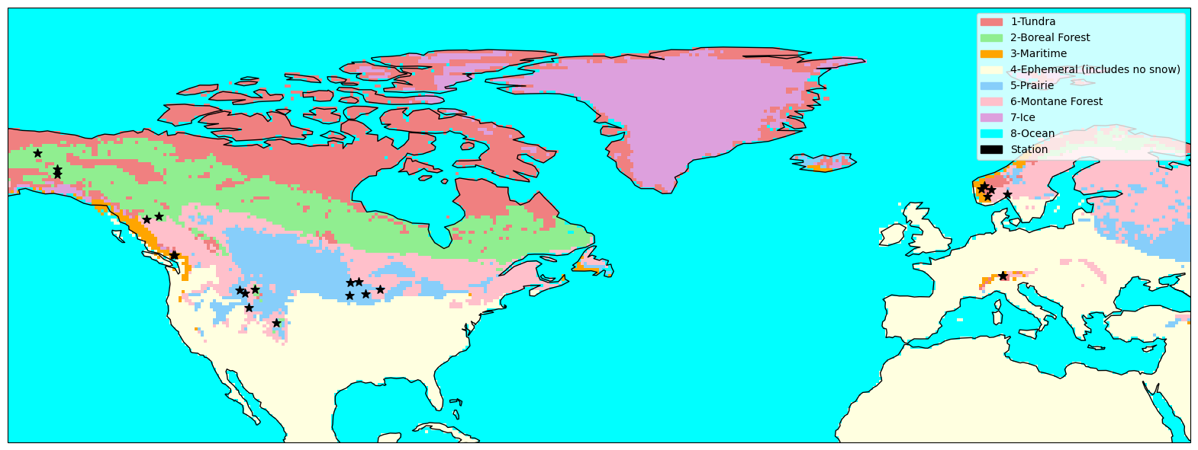
Data overview
Snow depth and SWE:
Total Records: 35,811 daily entries.
Covered Regions: Norway 🇳🇴, Canada 🇨🇦, Switzerland 🇨🇭, and United State of America 🇺🇸.
Meteorological Variables:
Source: ERA5-Land hourly data (1950-present).
Features Retrieved: Temperature (°C), Precipitation (m), Snowfall (m of water equivalent), Solar radiation (J m⁻²)
Snow Classification Scheme:
Dataset: Global Seasonal-Snow Classification by (Liston & Sturm, 2021)
Classes: Tundra, Boreal Forest, Maritime, Prairie, Montane Forest.
Notes:
The data I was using includes snow depth, swe, some meteorological variables such as temperature, precipitation, snowfall, and solar radiation. Also, I applied snow classification scheme introduced by Liston and Sturm in 2021 to classify the snow into different classes. And the data I used covered the countries from Norway, Canada, Switzerland and United State of America. Also covered the snow class from Tundra, Boreal Forest, Maritime, Prairie, and Montane Forest. The map showing below give overview of the data, each colour represent one of the snow class and the black star marker represents the station that the data comes from.

Slide 9
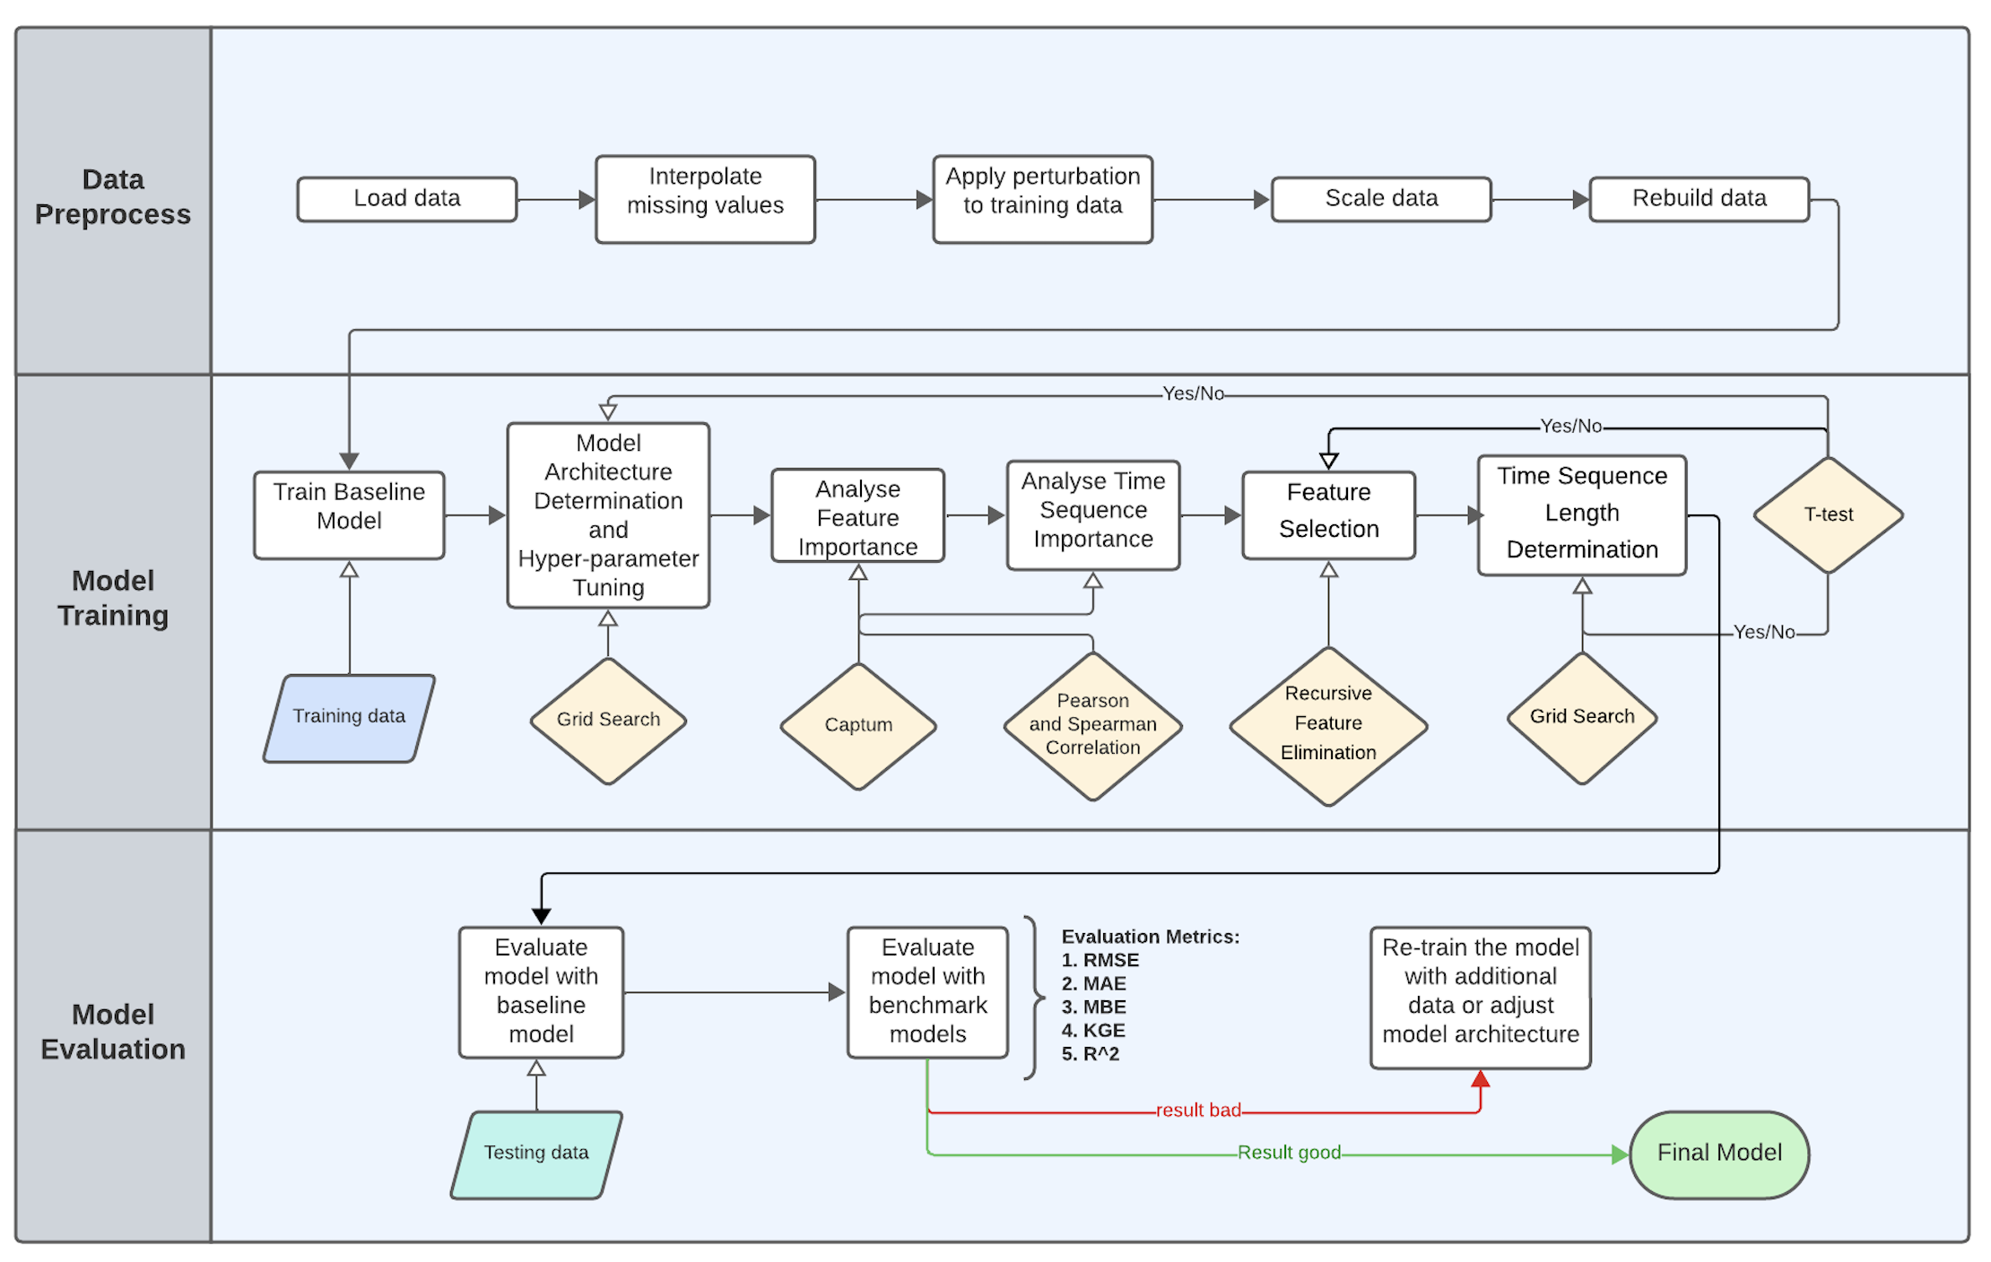

Slide 10
Method overview data pre-processing
Interpolating missing values.
Applying perturbations based on WMO’s guidelines.
Scaling.
Rebuilding the input data to the required shape
Split data
Notes:
Firstly, we split the data into training and testing data with a ratio of 8:2, and later we will split the data into training and validating set with a ratio of 8:2 again. Since it is a time series data so we didn’t shuffle the data.
Then I interpolate the missing values linearly, which is by averaging the values before and after the missing values.
And then I applied perturbations to reflect the uncertainty and enhance the model generalisability by following the guideline in World meteorological orgainsation. It states that if the measured snow depth is less than 20 centimeter, then the error should not be more than plus or minus 1 centimeter. And if if it the snow depth is more than or equal to 20 cm, the error should be around ±5%.
Given the considerable differences in magnitude across the input features — especially with variables like Solar radiation having values in the millions, it becomes crucial to normalise the data to ensure model stability during training.
And finally we rebuild the input data into required shape for LSTM model training.

Slide 11
Method overview LSTM Model Construction
Single Long Short Term Memory Model
SLSTM: Utilise the entire dataset
Muti-Long Short Term Memory Models
MLSTM: build five different models based on five different snow classes
1. Model Construction
2. Hyper-parameter Tuning & Architecture Adjustment
3. Meteorological Variables & Time Sequence Selection
4. Model Evaluation Metrics
Model Architectures: Evaluated using Grid Search (1-4 layers).
Number of Neurons: Tuned via Grid Search.
Number of Epochs: Tuned with Early Stopping.
Feature Selection:
1. Utilisation of 'Captum' tool.
2. Pearson and Spearman Correlation.
3. Recursive Feature Elimination.
Key Metrics: RMSE, MAE, MBE, KGE, R².
Notes:
Then we move on to the methodology part.
Firstly I construct two model, one utilise the entire dataset to train and the other one build five different models based on five different snow classes.
Then I use the grid search to do the hyper-parameter tuning and architecture adjustment, such as the determination of number of layers and number of neurons in each layer. And I also apply Early Stopping in determining the number of epochs.
After that, I begin to do the meteorological variables and sequence length selection, which also took me most of time. Firstly I use a package called ‘Captum’, which can analyse the weights of each feature inside the hidden layers. Combining with the spearman and pearson correlation to rank the feature according to their impact to predicting SWE. And finally do sensitivity analysis which is removing the features iteratively based on their importance ranking. And to compare the model performance before and after removing this feature.
Finally we move to the model performance part, the performance metrics I used are root mean square error, mean absolute error, mean bias error, Kling-Gupta Efficiency, and Coefficient of Determination.

Slide 12
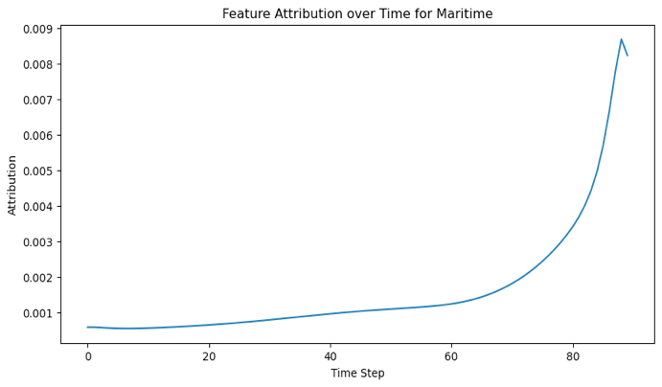
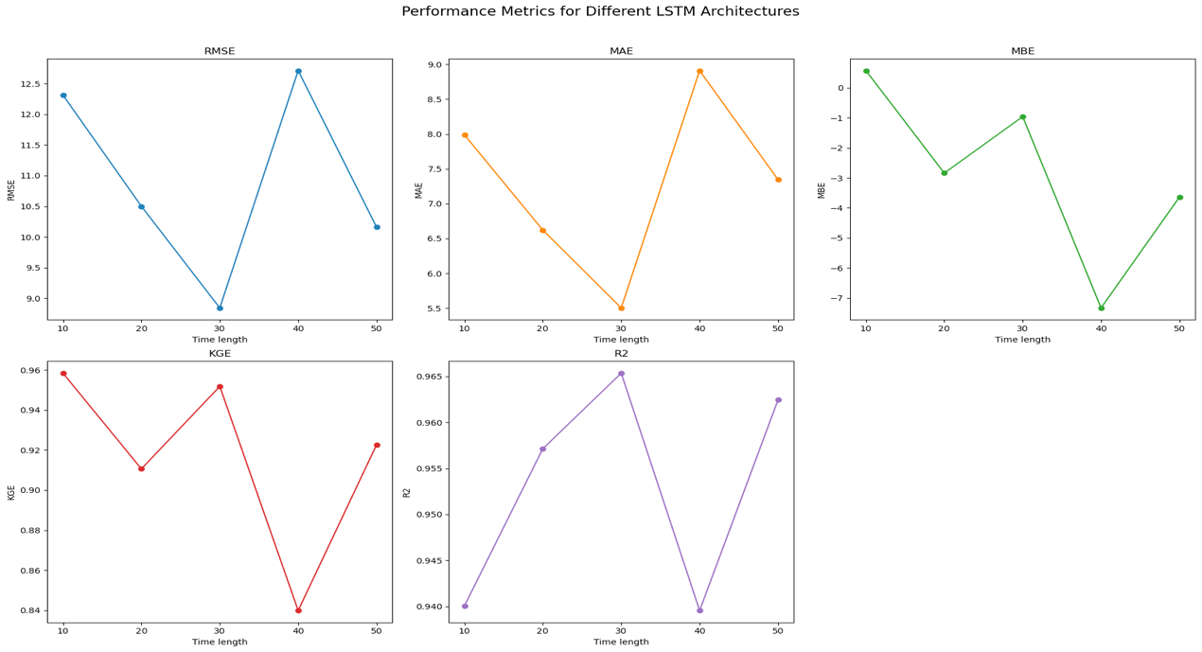
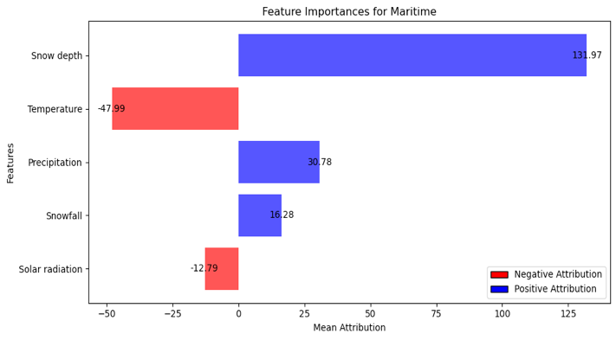
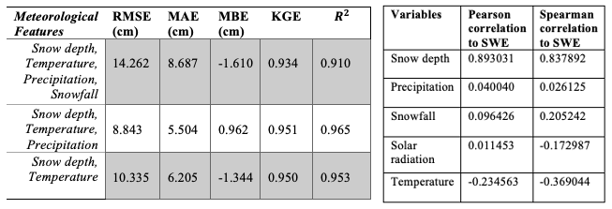
Method overview Meteorological Variables & Time Sequence Selection
Feature Selection
Employed ‘Captum’ technique for feature importance analysis.
Iterative removal based on importance.
Result: Optimal features - Snow depth, Temperature, Precipitation.
Time Sequence Selection
Visualised daily weights for key features (snow depth in most cases).
Evaluated sequences by grid search: 10, 20, 30, 40, 50-day.
Result: 30-day sequence chosen for best RMSE, MAE, and R².

Slide 13

Results

Slide 14
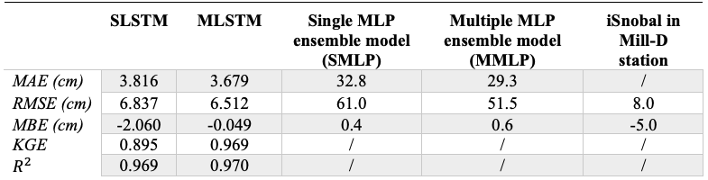
Results comparison between benchmark models
Performance Differences:
Both SLSTM and MLSTM shows better MAE and RMSE values compared to the benchmark models such as iSnobal model and ANN models.
The bias (MBE) for MLSTM is lower than both SMLP and MMLP.
Notes:
We firstly compare our models with benchmark models. The benchmark models being selected are the models from ANN models that I mentioned in deep learning appoarch, and the other one is iSnobal model, which is a physical model usually used in the industry.
Comparing the models, we see a dramatic improvement in both MAE and RMSE values.
The RMSE scores drop from 61.0 and 51.5, down to just 6.837 and 6.512 respectively.
MLSTM also shows a good result in MBE as well, showing a significantly reduced bias compared to all benchmark models.
Overall, both models, especially MLSTM, have a superior performance over the benchmark models.

Slide 15
Results comparison between models
Performance Highlights:
MLSTM outperforms SLSTM across all metrics.
MAE and RMSE for MLSTM are reduced by 4.68% and 3.59% respectively compared to SLSTM.
MBE for MLSTM drops by 76.21% from -2.060 cm to -0.049 cm.
Both SLSTM and MLSTM have a strong R² close to 1.
MLSTM's superior KGE score indicates better alignment with observed values on the test set.
Notes:
Then diving into our model performance, it's evident that MLSTM outstand SLSTM across every metric.
Let's break this down a bit: MLSTM have a better results in all RMSE, MAE and MBE metrics compared to SLSTM.
Both our models, SLSTM and MLSTM, have a close R2 score indicating a good fit to the data. The KGE score for MLSTM stands out. This high score suggests that our MLSTM's estimated values align more closely with the observed values in the test set.

Slide 16
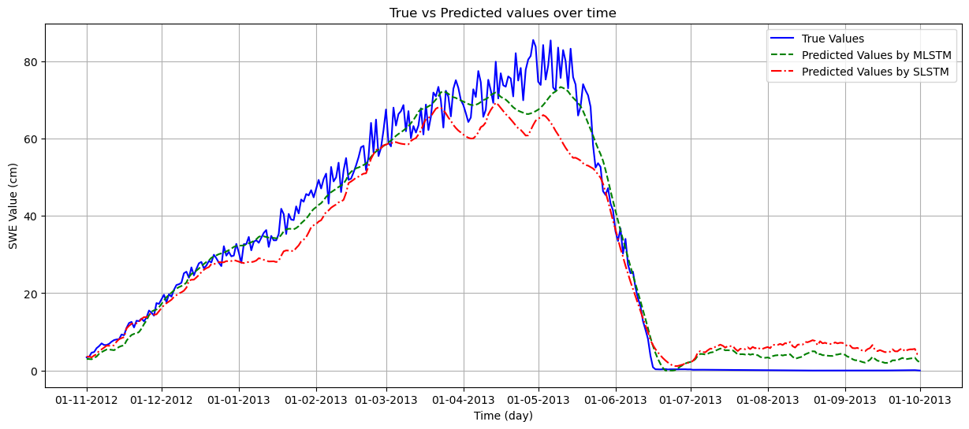
Result comparison between models
Performance Highlights:
Based on data from one of Canada station, MLSTM‘s predictions align more closely with the actual values.
MLSTM shows no obvious overfitting patterns, emphasizing its reliability and accuracy.
Notes:
The figure displays a line plot comparing the observed values and predicted values from SLSTM and MLSTM models at one of the canada station, which located in the Montane Forest snow class regions of Canada. As observed from the figure, the MLSTM predictions (represented by green line) are generally closer to the observed values than those from SLSTM (which is represented by red line). Overall, the model’s predictions demonstrate a consistent and stable trend while the observed data exhibits a large fluctuation. This not only indicates the model’s ability to capture the trend of data but also shows no obvious overfitting patterns. This result emphasises the MLSTM model’s reliability and accuracy.

Slide 17

Thank you!

